Slide 1
Used CAR price PREDICTION
Report Summary
Submitted by:
SANTOSH H. HULBUTTI
Intern @ Flip Robo Technologies

Slide 2
The Problem Statement
With the covid 19 impact in the market, we have seen lot of changes in the car market. Now some cars are in demand hence making them costly and some are not in demand hence cheaper. One of FlipRobo Technologies’ clients works with small traders, who sell used cars. With the change in market due to covid 19 impact, FlipRobo Technologies’ client is facing problems with their previous car price valuation machine learning models. So, they are looking for new machine learning models from new data. We have to make car price valuation model.
It is required to build a regression model using Machine Learning in order to predict price of the used car.

Slide 3
Feature Terminology
Brand – brand name of the car
Model – model name of the car
km_driven – total kilometers driven by the car
primary_fuel – primary fuel of the car
Transmission – type of transmission/gear train mechanism
registration_city – name of the city where the car registration was done
car_price – price of the car in Lakhs of rupees (Target variable)
color – color of the car
owner_type – level of Ownership transfer
insurance_type – is car insured as on the day of listing it on the website
reg_type – type of registration of car (individual/commercial/taxi/corporate etc)
engine_cap – volumetric capacity of the engine
cylinders – no. of cylinders in engine
max_power – max power of the engine
max_p_rpm – rpm at max power
max_torque – max torque of the engine
max_t_rpm – rpm at the max torque
mileage – average kilometers drive per 1 liter of fuel
drive_type – rear wheel drive/ front wheel drive/ all-wheel drive
turbocharger – is the car has turbocharger
car_segment – car segment based on the car length
ground_clear – ground clearance
registration_month – month of the registration
registration_year2 – year of the registration

Slide 4
EDA Steps & Assumptions
The data was scraped using selenium library & saved in CSV format.
There were 28 attributes (27 features and 1 target).
The target variable is continuous numeric data.
There was total 4060 rows of observation.
4 features namely, 'Unnamed: 0', ‘owner_comment’, ‘variant, ‘price_unit’, were removed.
Dropping unnecessary columns/features
Dropping Duplicate entries,
Checking for data consistency & unusual data entries,
Checking for unique entries, null values,
Checking for datatype count,
Skewness is removed using Yeo-Johnson Power Transformer.
Outliers are removed using Z-score method. Data loss observed was 1.13%.
Some features are removed as based on Correlation using seaborn heatmap & Multicollinearity check using VIF value:
Standard scaling is applied on the entire train & test data.

Slide 5
Visualizations
Plots used for Data Visualization:
Distribution plots
Scatter plots
Count plots
Box Plot
Bar plots
Heatmaps

Slide 6
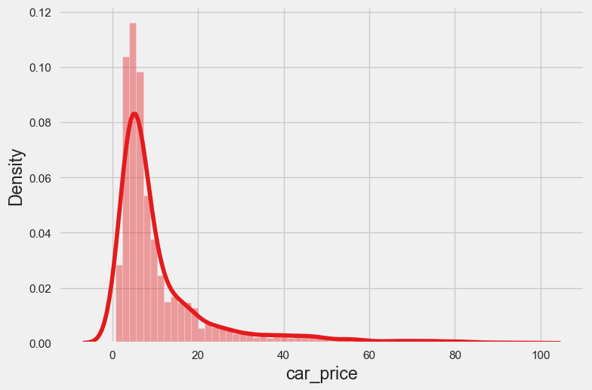
Target variable
From Cleaned data
Most of the cars price were less than 15Lakhs.

Slide 7
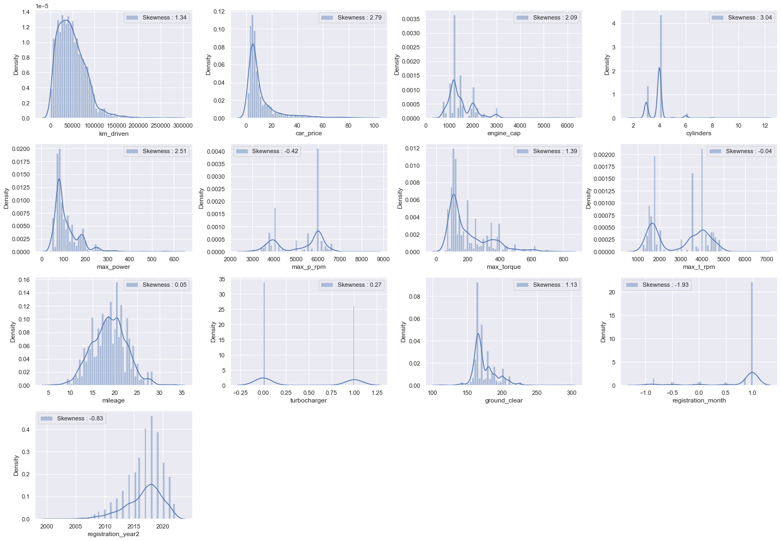
Independent Features
The cleaned data showed some features having normal distribution, & some with high right skewness. Some features were discrete numbers
Some of the features were highly skewed, outliers were also present.

Slide 8
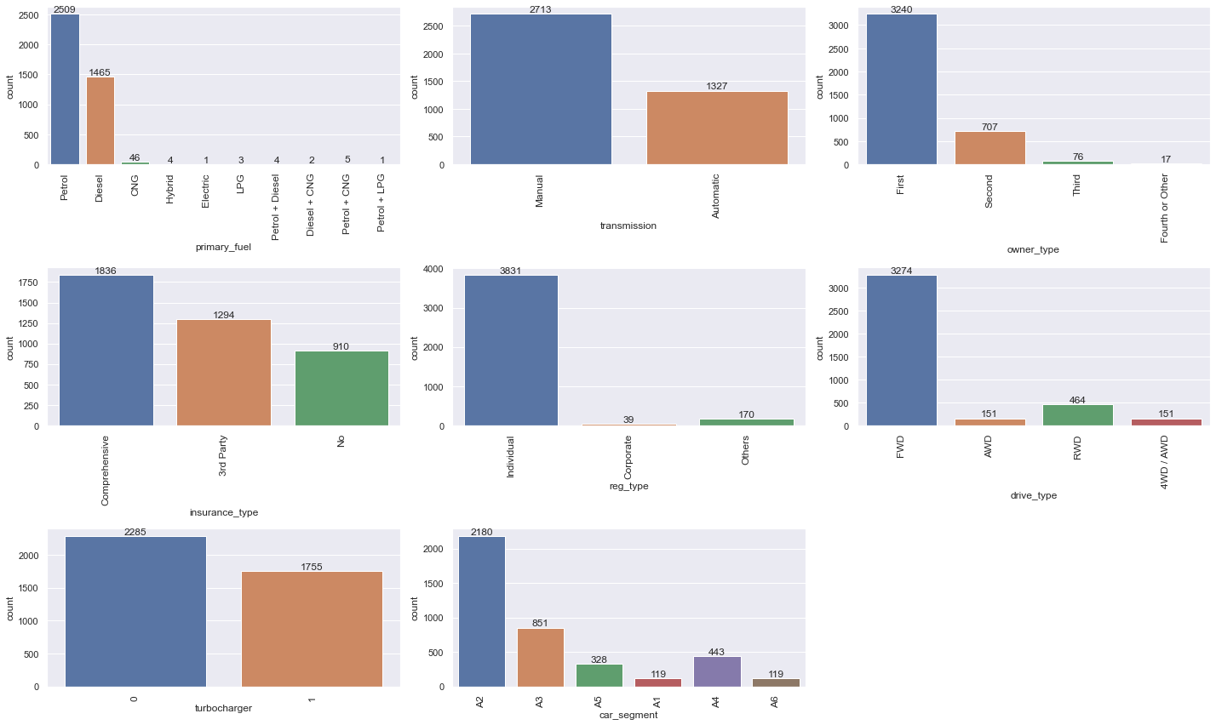
Independent Features
Petrol & diesel were the most commonly used primary fuel for cars.
Most of the cars were of A2 Class.

Slide 9
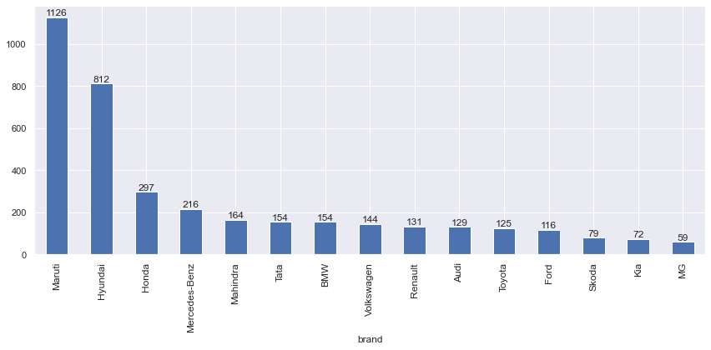
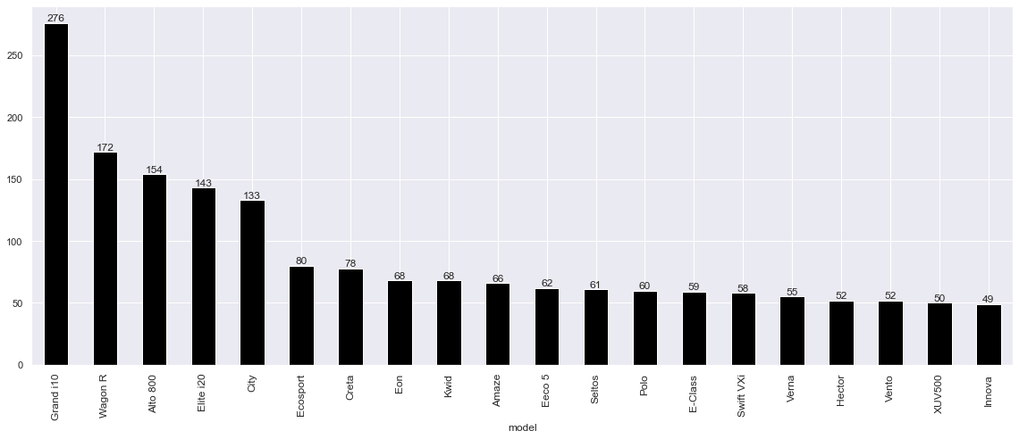
Independent Features
Maruti & Hyundai were the most common brands of the cars listed for selling.
Grand i10 & WagonR were common type of models sold online on carwale.com.

Slide 10
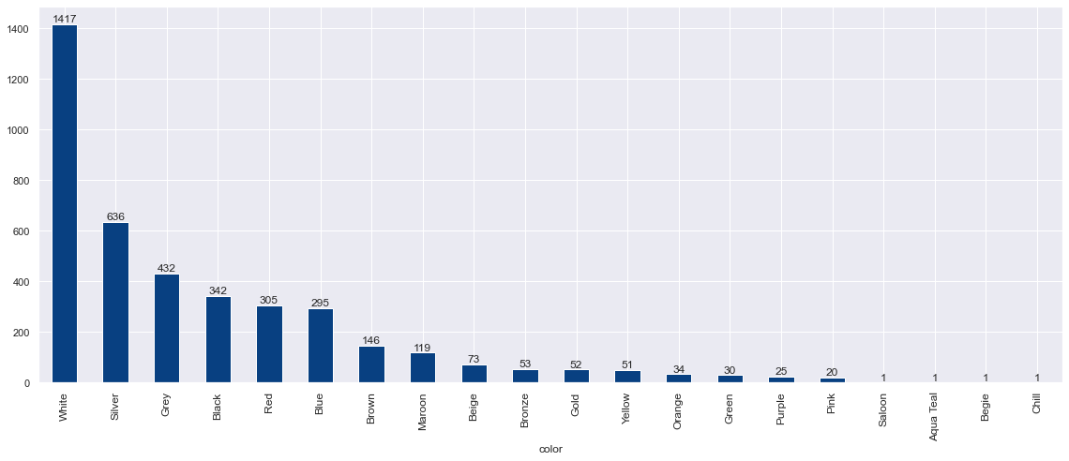
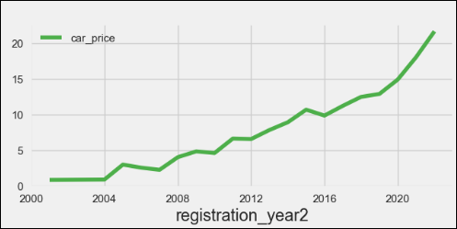
Independent Features
White was the most common color of the cars listed on carwale.com
Latest the registration year of the car higher the price of the car listed on carwale.com

Slide 11
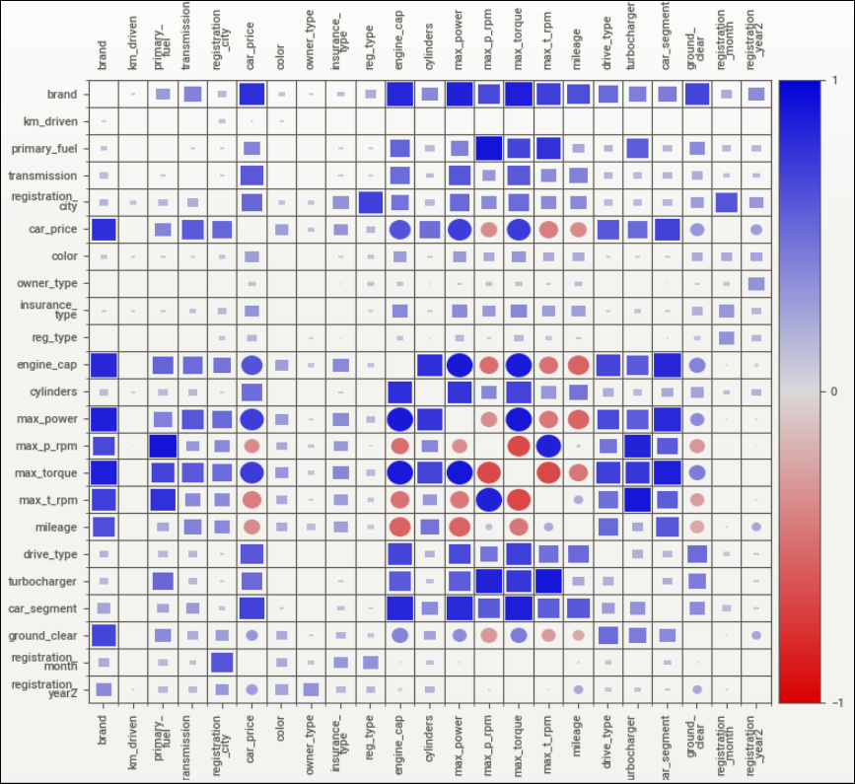
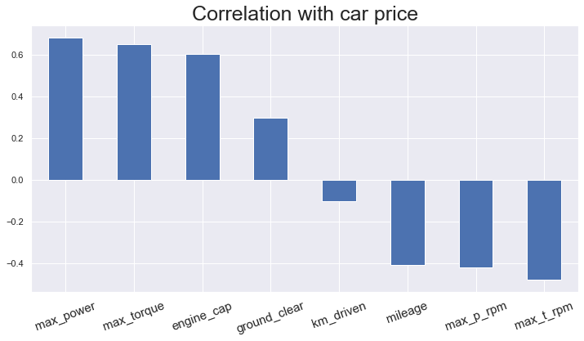
Bivariate Analysis
few features were showing negative correlation with target variable.

Slide 12
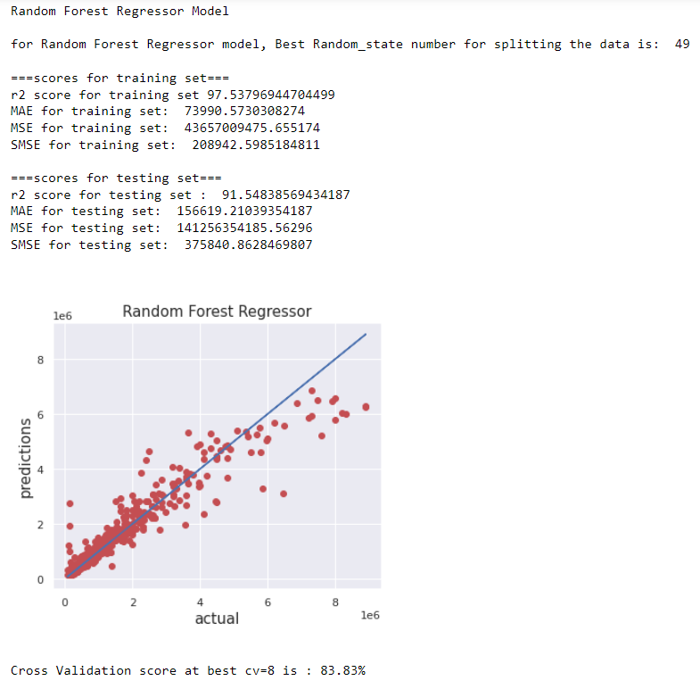
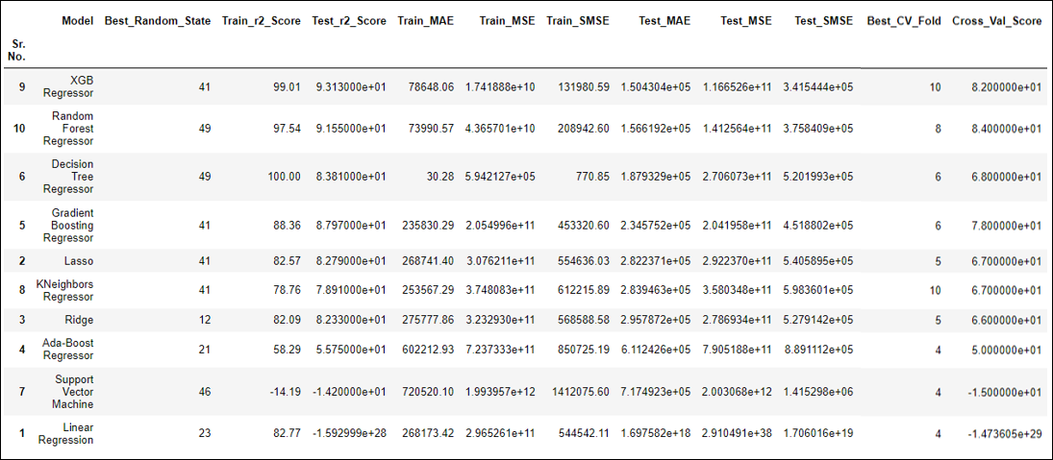
Finalized Model
We selected Random Forest Classifier for the following reasons:
minimum MAE value on test set & highest cross val score.
minimum difference between Cross val score & test score.

Slide 13
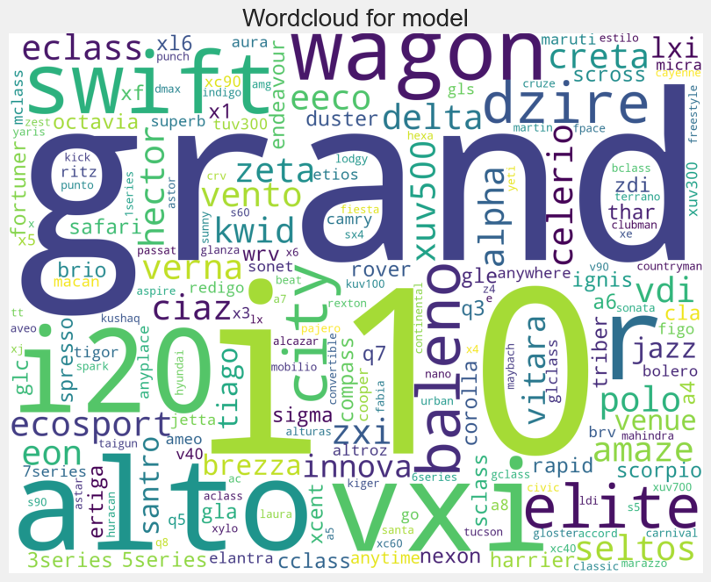
Conclusion
Petrol & diesel were the most commonly used primary fuel for cars.
Most of the cars were having manual transmission system as compared to Automatic transmission system.
Of all the cars listed on the website almost 70% of the cars were being sold for the first time from respective owners.
25% of the cars were not insured.
More than 90% of the cars were having Individual type of registrations.
More than 65% of the cars were front wheel driven.
Almost half of the listed cars were having turbocharger device.
Most of the cars were of A2 Class.
Maruti & Hyundai were the most common brands of the cars listed for selling.
Grand i10 & WagonR were common type of models sold online on carwale.com.
Hyderabad city had the greatest number of used car sellers.
White was the most common color of the cars listed on carwale.com
Engine volumetric capacity is positively correlated to cylinders, max power & max torque.
max power & max torque are positively correlated.
Latest the registration year of the car higher the price of the car listed on carwale.com
A3, A4 & A5 class of cars are costlier.
Cars with automatic transmission & turbocharger devices are usually costlier as seen from the graphs.

